Slide 1
Getting Started with AERONET: Downloading and Analyzing Aerosol Data
Tucson, University of Arizona
Aerosol Robotic Network
Armin Sorooshian
Soodabeh Namdari (soodabeh.namdari.rs@gmail.com)
August 2025

Slide 2
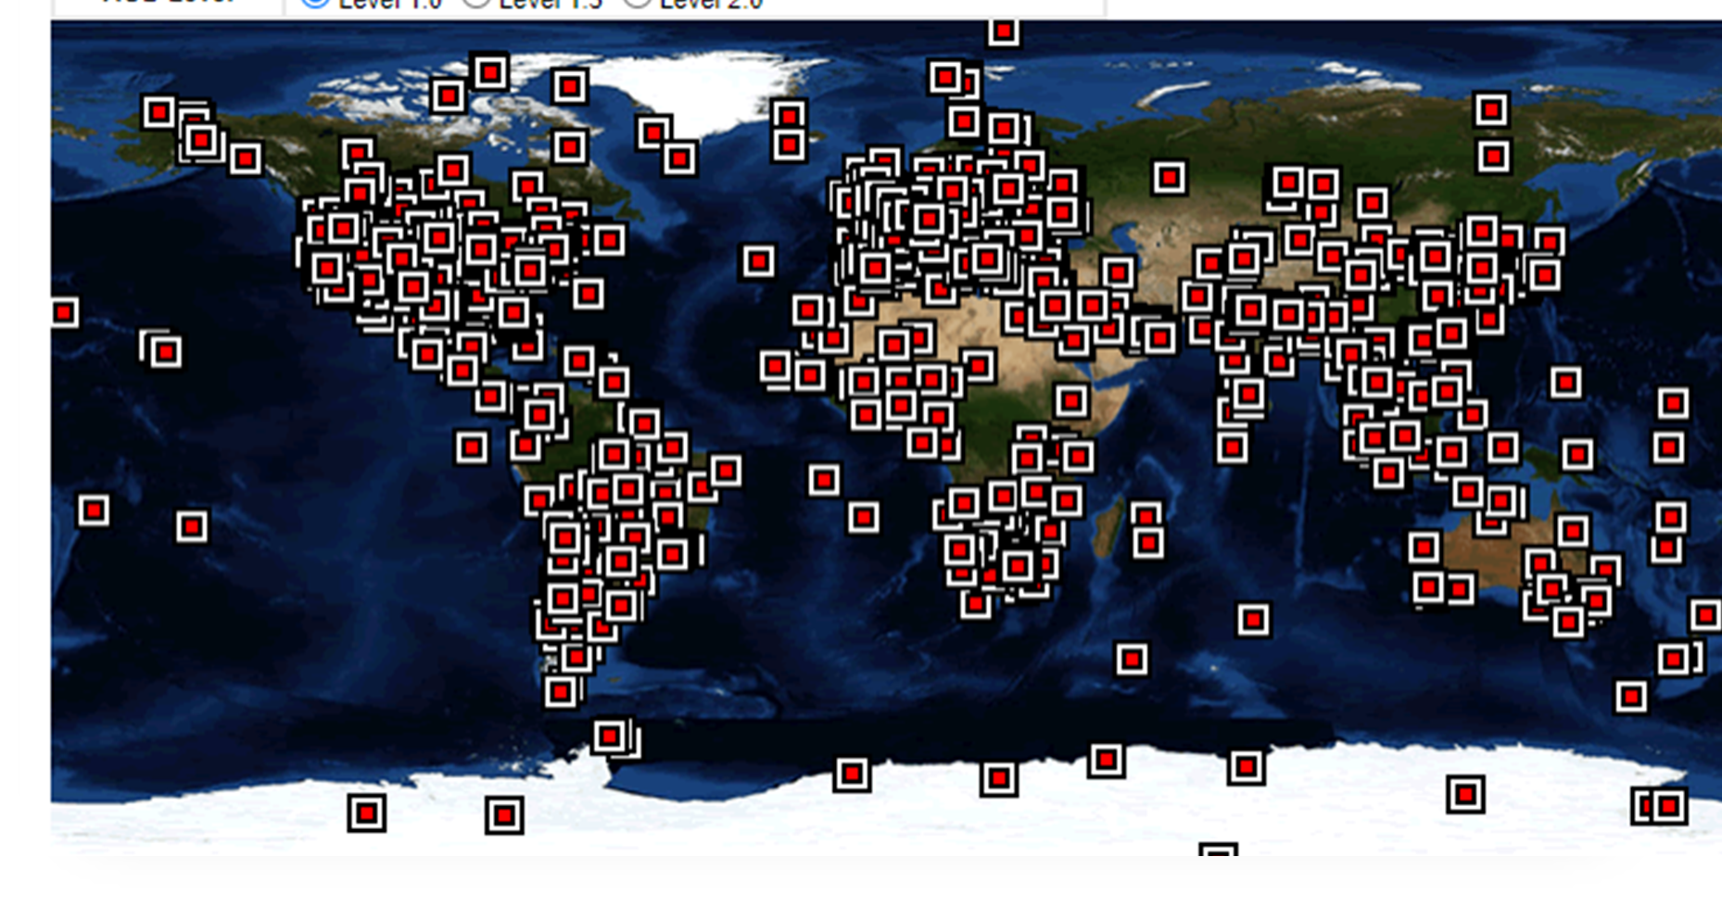
What is AERONET?
NASA's Aerosol Robotic Network, a global network of ground-based sun photometers. Covers hundreds of stations worldwide.
Measures Aerosol Optical Depth (AOD) and related aerosol properties.
AERONET location around the globe
Purpose of AERONET:
Long-term, accurate, and calibrated aerosol data for validation of satellite retrievals and models.
Useful in air quality studies, climate change, and remote sensing.
Long-term, continuous, and easily available public domain database of aerosol optical
Microphysical, and radiative characteristics for aerosol research and characterization,
Satellite retrieval validation, and database synergism for over 25 years.

Slide 3
What Does AERONET Measure?
AOD (Aerosol Optical Depth):
How much sunlight is blocked by aerosols.
Angstrom Exponent:
Spectral slope; tells if particles are large (dust) or small.
Precipitable Water:
Total water vapor in a column of atmosphere.
Measured at multiple wavelengths (340–1640 nm).
Data Levels
Level 1.0 – Raw, unfiltered data
Level 1.5 – Cloud-screened
Level 2.0 – Cloud-screened & quality-assured (recommended for analysis)

Slide 4
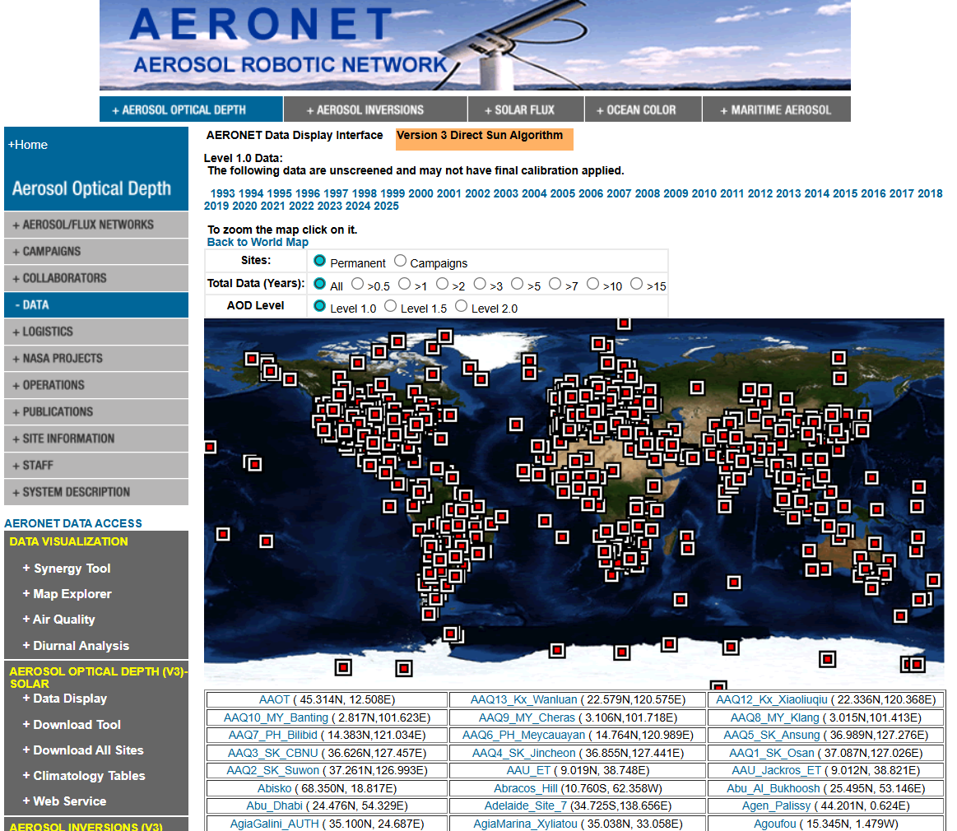
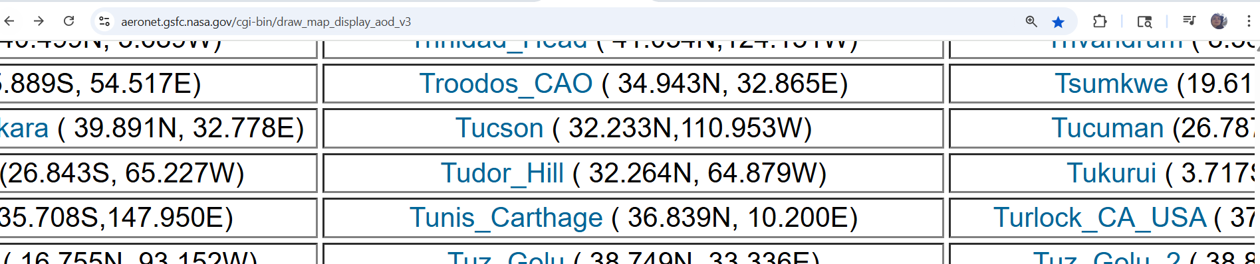
Accessing the Data
Go to: https://aeronet.gsfc.nasa.gov/cgi-bin/draw_map_display_aod_v3
2. Navigate to where you have Tucson and click on it

Slide 5
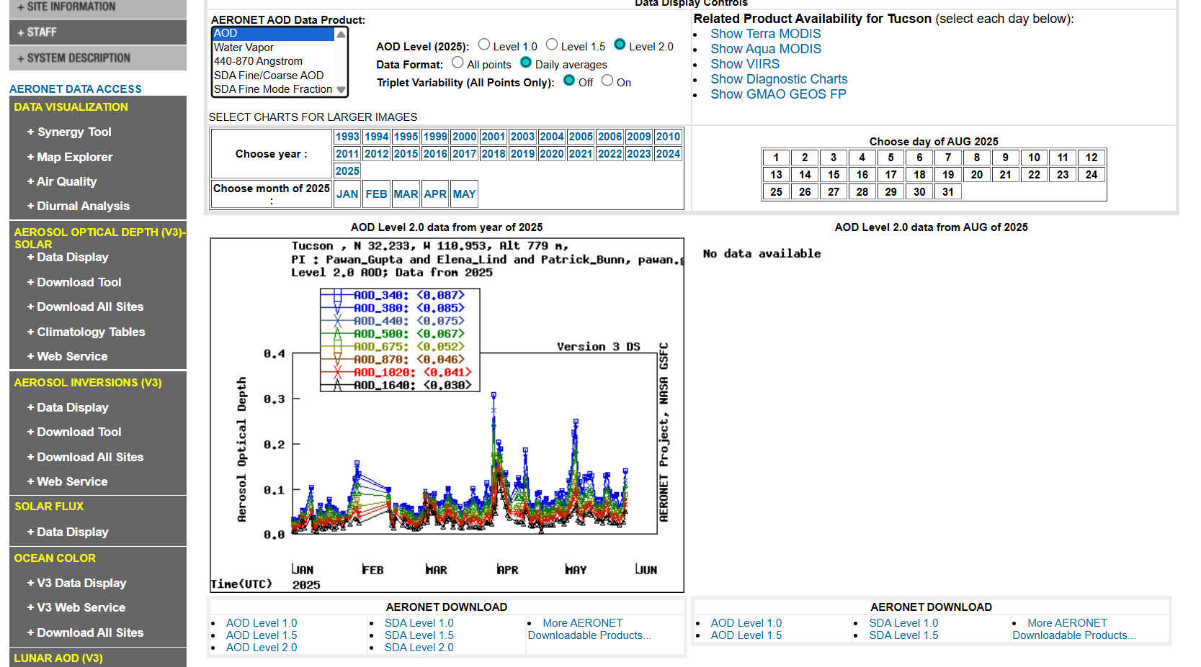

Click on the factor, year, and level 2.0 .
1
2
3
3
Clicking on this download the data in a zip file
4

Slide 6
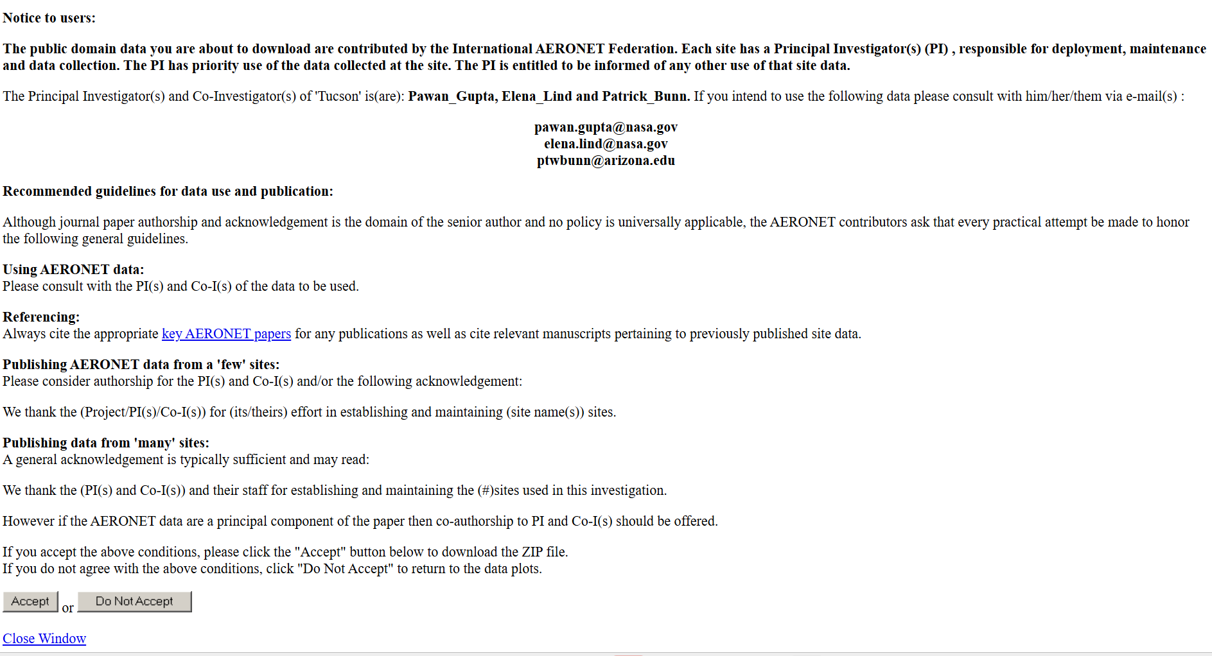

Slide 7

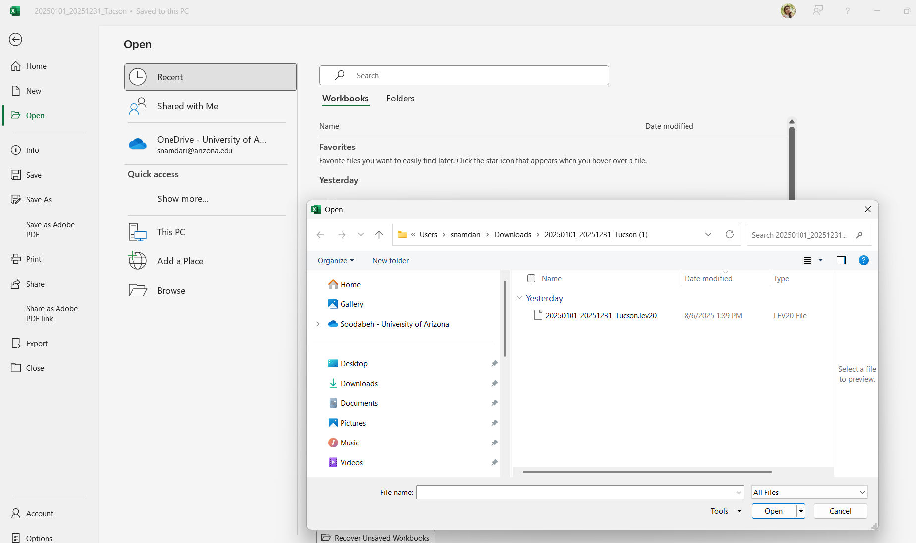
Data Extraction
Download the AERONET .zip file from the website.
Extract the file using WinRAR or Windows Explorer. → You will get a .lev20 file (text-based).
In Excel, go to File > Open and navigate to the folder. → Be sure to select “All Files” to see .lev20 files.

Slide 8
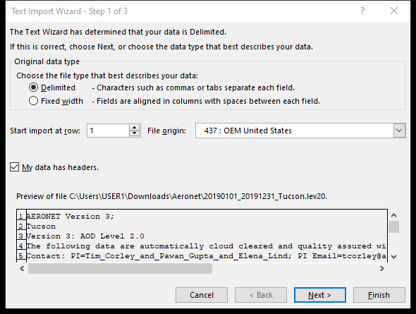
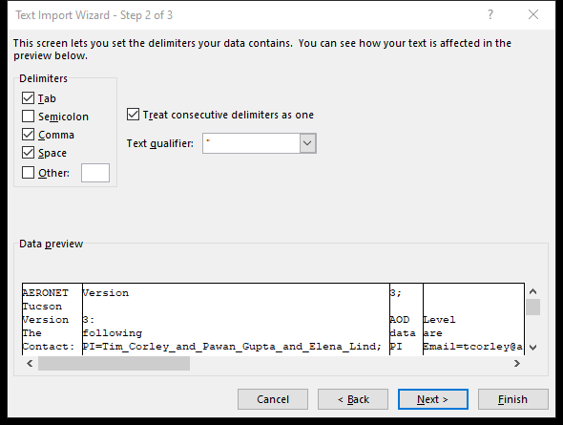
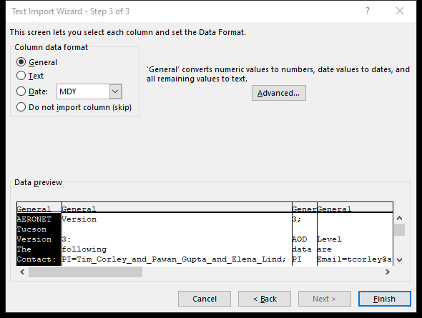
4
8
1
5
6
2
3
7
9
Step 1: In the Text Import Wizard, choose:
"Delimited" as file type
Check "My data has headers"
Click Next
Step 2: Select Comma as the delimiter
Uncheck "Tab" and "Space"
Click Next
Step 3 : Keep format as General
Click Finish
The data is now open in Excel!

Slide 9
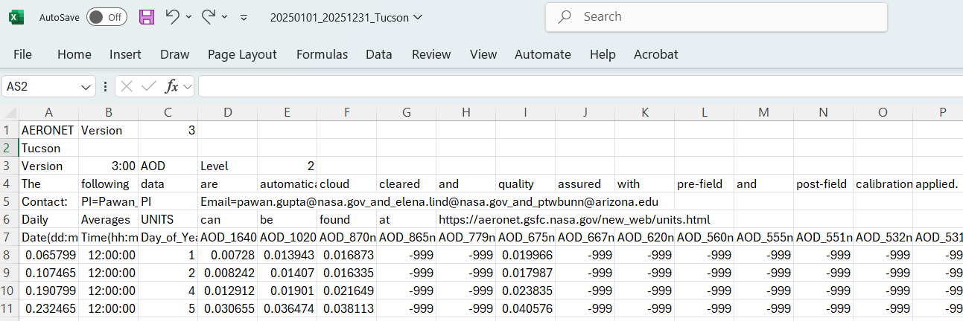
Text header (instrument/site metadata)
CSV table with:Date, Time, AOD_500nm, Angstrom_Exponent, Precipitable_Water
Many other AOD values by wavelength
Clean data starts after line 7 (use skiprows=6 in Python)
Rows contain AOD data (e.g., AOD_500nm, Angstrom_Exponent, etc.)
-999 values indicate missing or invalid data

Slide 10
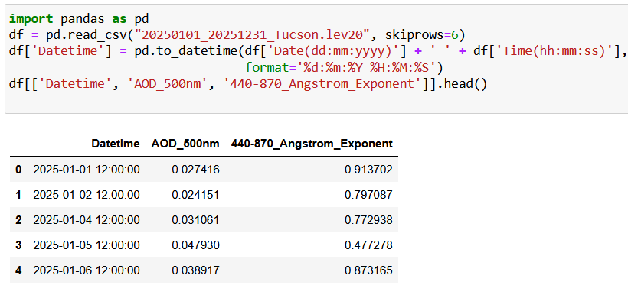
Data Reading and Visualization in Python
Load and Explore AERONET in Python

Slide 11
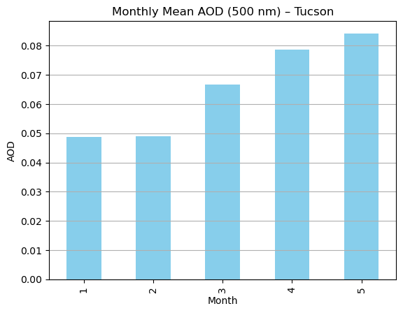
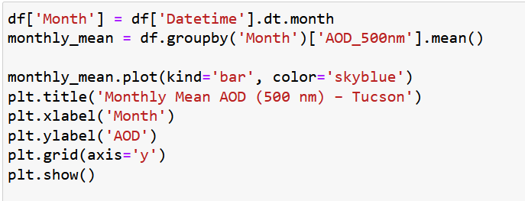
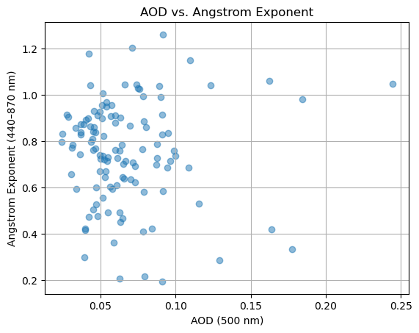
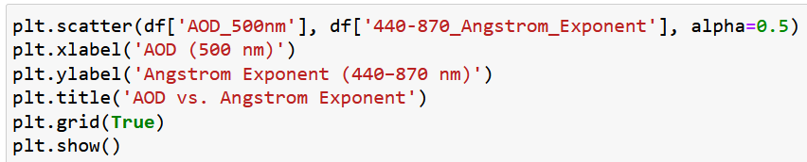
Monthly Averages or Seasonal Trends
AOD vs. Angstrom Exponent Scatterplot

Slide 12
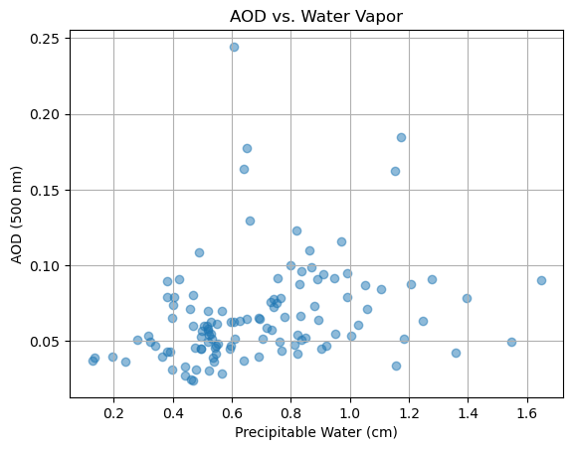
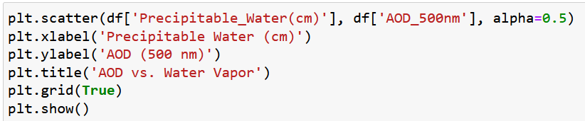
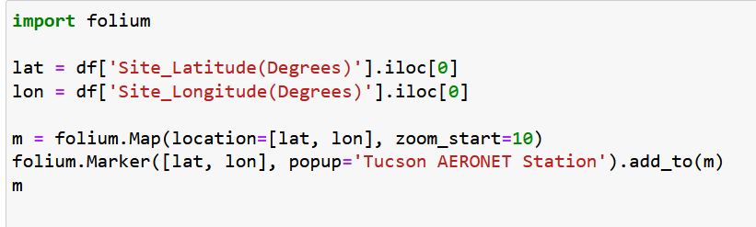
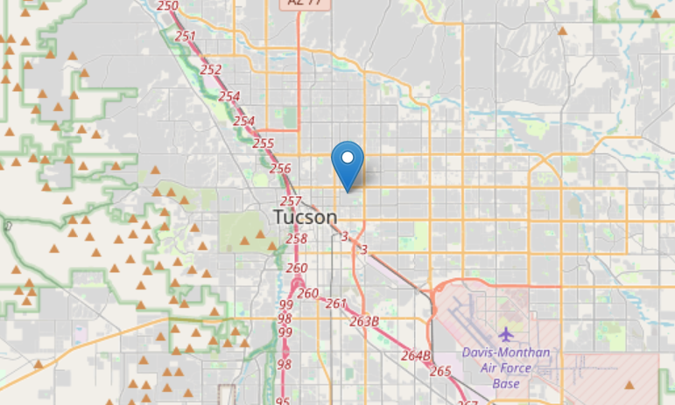
Precipitable Water vs. AOD
Geolocate AERONET station.

Slide 13
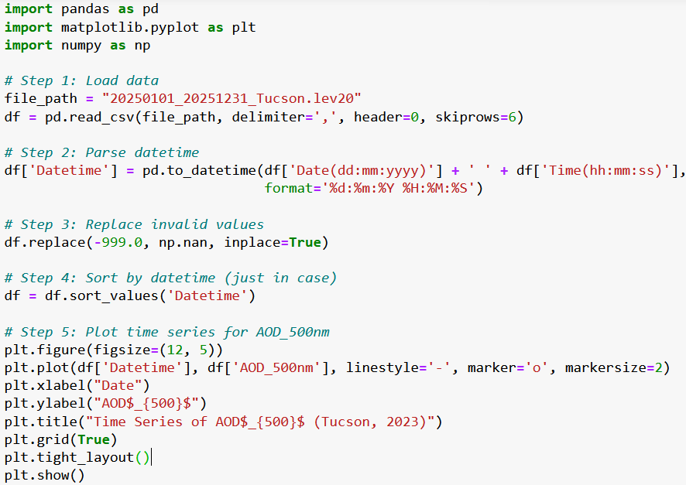
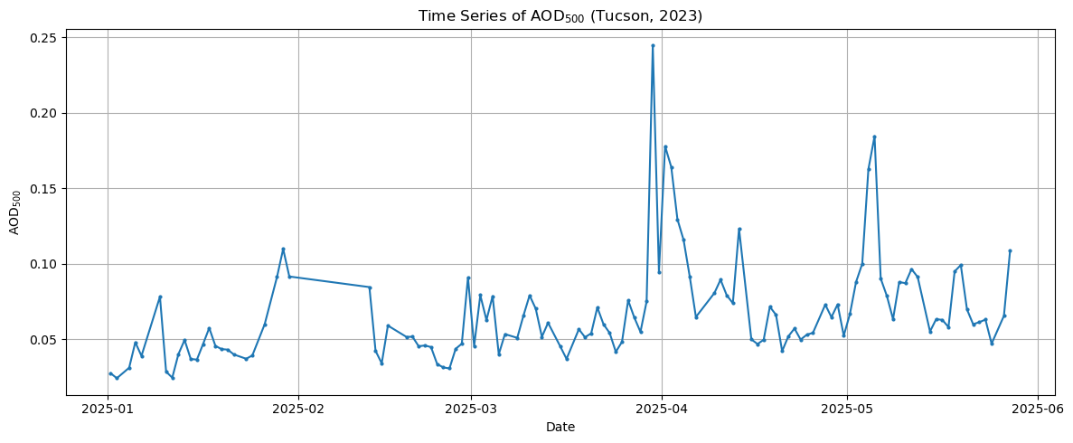
AOD Time Series Plot (500 nm)

Slide 14
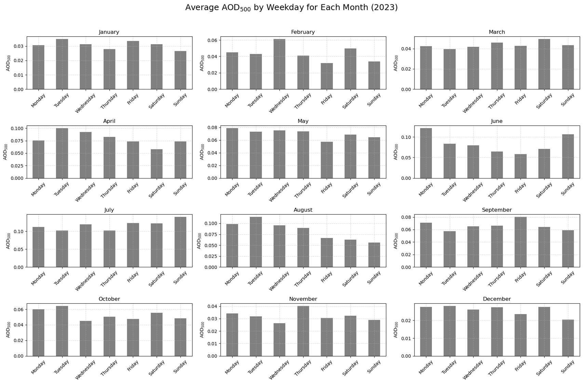
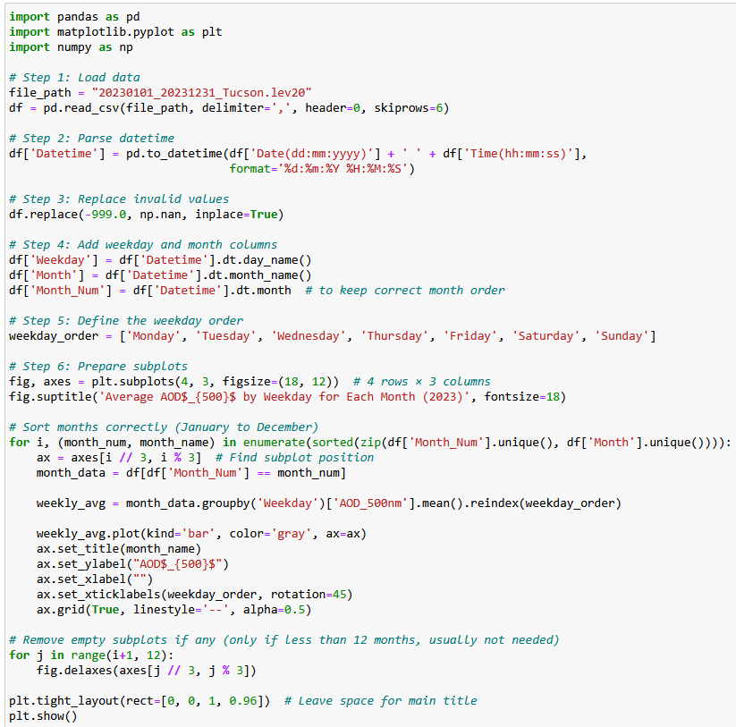
AOD Variability by Weekday and Month

Slide 15
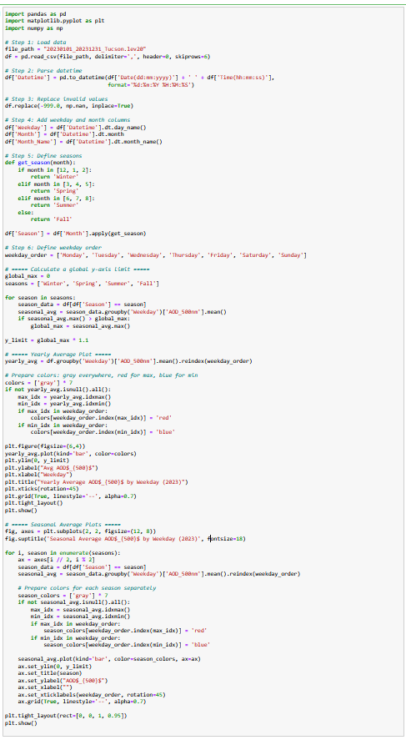
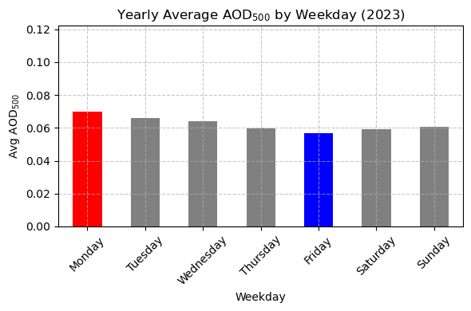
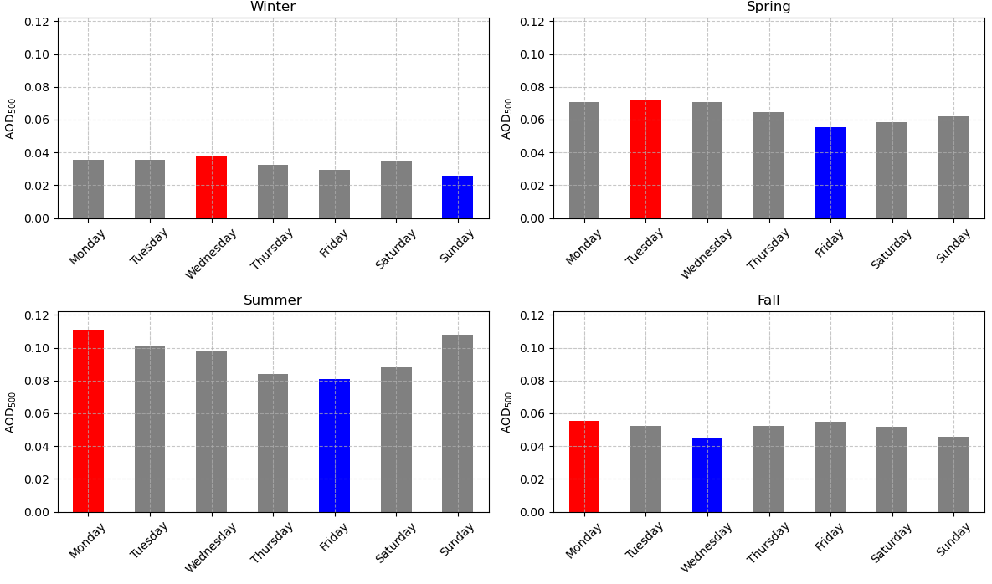
Weekday Variability of AOD
Across Year and Seasons

Slide 16
Thanks

